Slide 1

Chapter 6:
Project Time Management
Information Technology Project Management, Seventh Edition
Note: See the text itself for full citations.

Slide 2
讨论问题
1、项目时间管理中的7个主要过程
2、一个进度管理计划应该包括哪些信息？
3、依赖的三种类型
4、辅助进度制订过程的工具和技术有哪些？
5、SMART准则是怎样定义里程碑的？
6、使用关键路径来缩短项目进度有哪三个主要技术？

Slide 3
Learning Objectives
Understand the importance of project schedules and good project time management
Discuss the process of planning schedule management
Define activities as the basis for developing project schedules
Describe how project managers use network diagrams and dependencies to assist in activity sequencing
Understand the relationship between estimating resources and project schedules
Explain how various tools and techniques help project managers perform activity duration estimates

Slide 4
Learning Objectives
Use a Gantt chart for planning and tracking schedule information, find the critical path for a project, and describe how critical chain scheduling and the Program Evaluation and Review Technique (PERT) affect schedule development
Discuss how reality checks and discipline are involved in controlling and managing changes to the project schedule
Describe how project management software can assist in project time management and review words of caution before using this software

Slide 5
Importance of Project Schedules
Managers often cite delivering projects on time as one of their biggest challenges
Time has the least amount of flexibility; it passes no matter what happens on a project
Schedule issues are the main reason for conflicts on projects, especially during the second half of projects

Slide 6
Individual Work Styles and Cultural Differences Cause Schedule Conflicts
One dimension of the Meyers-Briggs Type Indicator focuses on peoples’ attitudes toward structure and deadline
Some people prefer to follow schedules and meet deadlines while others do not (J vs. P)
Difference cultures and even entire countries have different attitudes about schedules

Slide 7
迈尔斯布里格斯类型指标(MBTI)表征人的性格，是由美国的凯恩琳·布里格斯和她的女儿伊莎贝尔·布里格斯·迈尔斯制定的。该指标以瑞士心理学家荣格划分的8种类型为基础，加以扩展，形成四个维度，每个点对应每个人的性格。
  ① 外倾(E)－内倾(I)
  ② 感觉(S)－直觉(N)
  ③ 思维(T)－情感(F)
  ④ 判断(J)－知觉(P)

Slide 8
外倾－内倾
外倾型 内倾型
与他人相处精力充沛 独自度过时光精力充沛 行动
之后思考 思考， 之后行动 喜欢边想边说出声
在心中思考问题 易于“读”和了解；随意地分享个人情况 更封闭，更愿意在经挑选的小群体中分享个人的情况
说的多于听的 听的比说的多
高度热情地社交 不把兴奋说出来
反应快，喜欢快节奏 仔细考虑后，才有所反应
重于广度而不是深度 喜欢深度而不是广度

Slide 9
感觉－直觉
感觉型 直觉型
相信确定和有型的东西 相信灵感和推断
喜欢新想法—除非它们有实际意义 为了自己的利益，喜欢新思想和概念
重视现实性和常情 重视想象力和独创力
喜欢使用和琢磨已知的技能 喜欢学习新技能，但掌握之后很容易就厌倦了
留心具体的和特殊的； 进行细节描述
留心普遍的和有象征性的； 使用隐喻和类比
循序渐进地讲述有关情况 跳跃性地展现事实
着眼于现实 以一种绕圈子的方式着眼于未来

Slide 10
思维－情感
思维型 情感型
退后一步思考，对问题进行非个人因素的分析 超前思考，考虑行为对他人的影响
重视符合逻辑、公正、公平的价值； 一视同仁 重视同情与和睦：重视准则的例外性
被认为冷酷、麻木、漠不关心 被认为感情过多，缺少逻辑性，软弱
认为圆通比坦率更重要 认为圆通与坦率同样重要
只有情感符合逻辑时，才认为它可取 无论是否有意义，认为任何感情都可取
被渴望成就而激励 被为了获得欣赏而激励
很自然地看到缺点，倾向于批评

Slide 11
判断－知觉
判断型 知觉型
做了决定后最为高兴 当各种选择都存在时，感到高兴
有“工作原则”：工作第一，玩其次（如果有时间的话） “玩的原则”：现在享受，然后再完成工作
建立目标，准时地完成 随着新信息的获取，不断改变目标
愿意知道它们将面对的情况 喜欢适应新情况 着重结果（重点在于完成任务）
着重过程（重点在于如何完成工作） 满足感来源于完成计划 满足感来源于计划的开始
把时间看作有限的资源，认真地对待最后期限
认为时间是可更新的资源，而最后期限也是有收缩的

Slide 12
所属类型
内倾感觉思维判断（ISTJ） 内倾感觉情感判断（ISFJ）
内倾直觉情感判断（INFJ） 内倾直觉思维判断（INTJ）
内倾感觉思维知觉（ISTP） 内倾感觉情感知觉（ISFP）
内倾直觉情感知觉（INFP） 内倾直觉思维知觉（INTP）
外倾感觉思维判断（ESTJ） 外倾感觉情感判断（ESFJ
外倾直觉情感判断（ENFJ） 外倾直觉思维判断（ENTJ）
外倾感觉思维知觉（ESTP） 外倾感觉情感知觉（ESFP）
外倾直觉情感知觉（ENFP） 外倾直觉思维知觉（ENTP）

Slide 13
Media Snapshot
In contrast to the 2002 Salt Lake City Winter Olympic Games (see Chapter 4’s Media Snapshot), planning and scheduling was very different for the 2004 Summer Olympic Games held in Athens, Greece
Many articles were written before the opening ceremonies predicting that the facilities would not be ready in time. …many people were pleasantly surprised by the amazing opening ceremonies, beautiful new buildings, and state-of-the-art security and transportation systems in Athens
The Greeks even made fun of critics by having construction workers pretend to still be working as the ceremonies began

Slide 14
Project Time Management Processes
Planning schedule management: determining the policies, procedures, and documentation that will be used for planning, executing, and controlling the project schedule
Defining activities: identifying the specific activities that the project team members and stakeholders must perform to produce the project deliverables
Sequencing activities: identifying and documenting the relationships between project activities
Estimating activity resources: estimating how many resources a project team should use to perform project activities
Estimating activity durations: estimating the number of work periods that are needed to complete individual activities
Developing the schedule: analyzing activity sequences, activity resource estimates, and activity duration estimates to create the project schedule
Controlling the schedule: controlling and managing changes to the project schedule

Slide 15
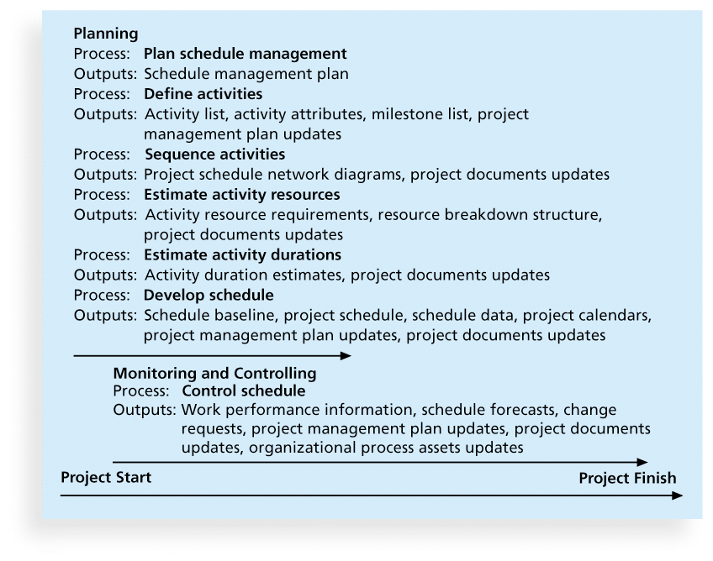
Figure 6-1. Project Time Management Summary

Slide 16
Planning Schedule Management
The project team uses expert judgment, analytical techniques, and meetings to develop the schedule management plan
A schedule management plan includes:
  Project schedule model development
  The scheduling methodology
  Level of accuracy and units of measure
  Control thresholds
  Rules of performance measurement
  Reporting formats
  Process descriptions

Slide 17
Defining Activities
An activity or task is an element of work normally found on the work breakdown structure (WBS) that has an expected duration, a cost, and resource requirements
Activity definition involves developing a more detailed WBS and supporting explanations to understand all the work to be done so you can develop realistic cost and duration estimates

Slide 18
Activity Lists and Attributes
An activity list is a tabulation of activities to be included on a project schedule that includes
  the activity name
  an activity identifier or number
  a brief description of the activity
Activity attributes provide more information such as predecessors, successors, logical relationships, leads and lags, resource requirements, constraints, imposed dates, and assumptions related to the activity

Slide 19
Milestones
A milestone is a significant event that normally has no duration
It often takes several activities and a lot of work to complete a milestone
They’re useful tools for setting schedule goals and monitoring progress
Examples include obtaining customer sign-off on key documents or completion of specific products

Slide 20
What Went Wrong?
At the U.S. Federal Bureau of Investigation (FBI), poor time management was one of the reasons behind the failure of Trilogy, a “disastrous, unbelievably expensive piece of vaporware, which was more than four years in the (un)making. The system was supposed to enable FBI agents to integrate intelligence from isolated information silos within the Bureau.”*
In May 2006, the Government Accounting Agency said that the Trilogy project failed at its core mission of improving the FBI’s investigative abilities and was plagued with missed milestones and escalating costs. Sentinel replaced Trilogy in 2007.
During a test exercise in 2011, Sentinel experienced two outages, and the FBI determined that the current hardware structure was inadequate. Unfortunately, history seemed to repeat itself as troubles still loomed with Sentinel in 2012
*Roberts, Paul, “Frustrated contractor sentenced for hacking FBI to speed deployment,”
InfoWorld Tech Watch, (July 6, 2006).

Slide 21
Sequencing Activities
Involves reviewing activities and determining dependencies
A dependency or relationship is the sequencing of project activities or tasks
You must determine dependencies in order to use critical path analysis

Slide 22
Three types of Dependencies
Mandatory dependencies: inherent in the nature of the work being performed on a project, sometimes referred to as hard logic
Discretionary dependencies: defined by the project team., sometimes referred to as soft logic and should be used with care since they may limit later scheduling options
External dependencies: involve relationships between project and non-project activities

Slide 23
Network Diagrams
Network diagrams are the preferred technique for showing activity sequencing
A network diagram is a schematic display of the logical relationships among, or sequencing of, project activities
Two main formats are the arrow and precedence diagramming methods

Slide 24
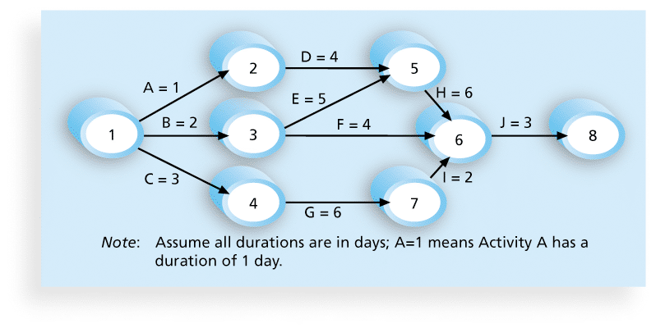
Figure 6-2. Network Diagram for Project X

Slide 25
Arrow Diagramming Method (ADM)
Also called activity-on-arrow (AOA) network diagrams
Activities are represented by arrows
Nodes or circles are the starting and ending points of activities
Can only show finish-to-start dependencies

Slide 26
Process for Creating AOA Diagrams
1. Find all of the activities that start at node 1. Draw their finish nodes and draw arrows between node 1 and those finish nodes. Put the activity letter or name and duration estimate on the associated arrow
2. Continuing drawing the network diagram, working from left to right. Look for bursts and merges. Bursts occur when a single node is followed by two or more activities. A merge occurs when two or more nodes precede a single node
3. Continue drawing the project network diagram until all activities are included on the diagram that have dependencies
4. As a rule of thumb, all arrowheads should face toward the right, and no arrows should cross on an AOA network diagram

Slide 27
Precedence Diagramming Method (PDM)
Activities are represented by boxes
Arrows show relationships between activities
More popular than ADM method and used by project management software
Better at showing different types of dependencies

Slide 28
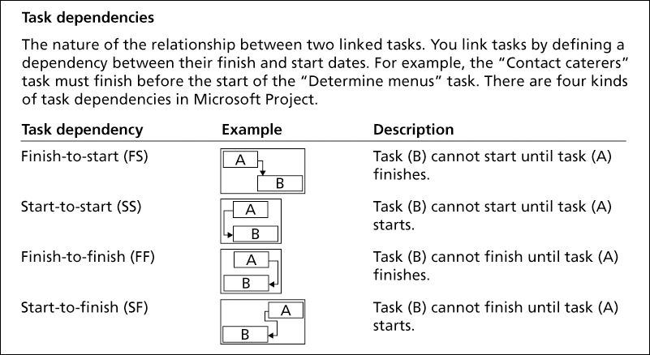
Figure 6-3. Task Dependency Types

Slide 29
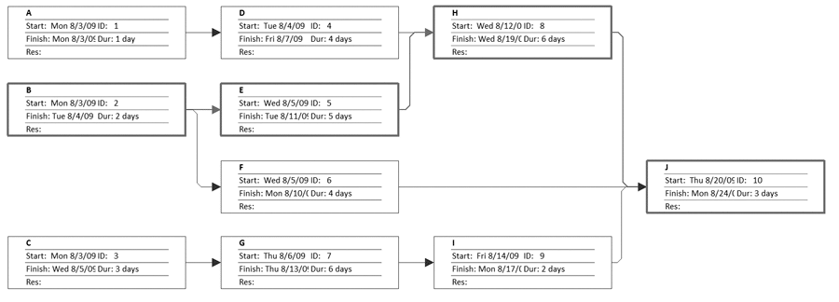
Figure 6-4. Sample PDM Network Diagram

Slide 30
Estimating Activity Resources
Before estimating activity durations, you must have a good idea of the quantity and type of resources that will be assigned to each activity; resources are people, equipment, and materials
Consider important issues in estimating resources
  How difficult will it be to do specific activities on this project?
  What is the organization’s history in doing similar activities?
  Are the required resources available?
A resource breakdown structure is a hierarchical structure that identifies the project’s resources by category and type

Slide 31
Activity Duration Estimating
Duration includes the actual amount of time worked on an activity plus elapsed time
Effort is the number of workdays or work hours required to complete a task
Effort does not normally equal duration
People doing the work should help create estimates, and an expert should review them

Slide 32
Three-Point Estimates
Instead of providing activity estimates as a discrete number, such as four weeks, it’s often helpful to create a three-point estimate
  an estimate that includes an optimistic, most likely, and pessimistic estimate, such as three weeks for the optimistic, four weeks for the most likely, and five weeks for the pessimistic estimate
Three-point estimates are needed for PERT and Monte Carlo simulations

Slide 33
Developing the Schedule
Uses results of the other time management processes to determine the start and end date of the project
Ultimate goal is to create a realistic project schedule that provides a basis for monitoring project progress for the time dimension of the project
Important tools and techniques include Gantt charts, critical path analysis, and critical chain scheduling, and PERT analysis

Slide 34
Gantt Charts
Gantt charts provide a standard format for displaying project schedule information by listing project activities and their corresponding start and finish dates in a calendar format
Symbols include:
  A black diamond: a milestones
  Thick black bars: summary tasks
  Lighter horizontal bars: durations of tasks
  Arrows: dependencies between tasks

Slide 35
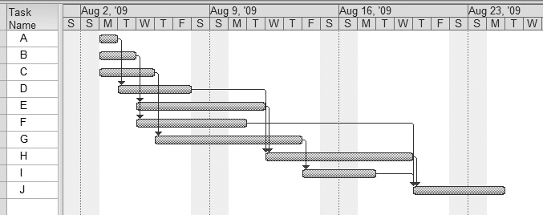
Figure 6-5. Gantt Chart for Project X

Slide 36
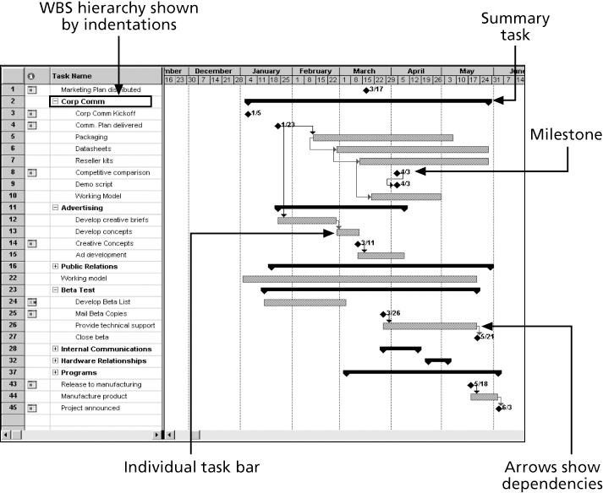
Figure 6-6. Gantt Chart for Software Launch Project

Slide 37
Adding Milestones to Gantt Charts
Many people like to focus on meeting milestones, especially for large projects
Milestones emphasize important events or accomplishments on projects
Normally create milestone by entering tasks with a zero duration, or you can mark any task as a milestone

Slide 38
SMART Criteria
Milestones should be
  Specific
  Measurable
  Assignable
  Realistic
  Time-framed

Slide 39
Best Practice
Schedule risk is inherent in the development of complex systems. Luc Richard, the founder of www.projectmangler.com, suggests that project managers can reduce schedule risk through project milestones, a best practice that involves identifying and tracking significant points or achievements in the project. The five key points of using project milestones include the following:
  1. Define milestones early in the project and include them in the Gantt chart to provide a visual guide
  2. Keep milestones small and frequent
  3. The set of milestones must be all-encompassing
  4. Each milestone must be binary, meaning it is either complete or incomplete.
  5. Carefully monitor the critical path

Slide 40
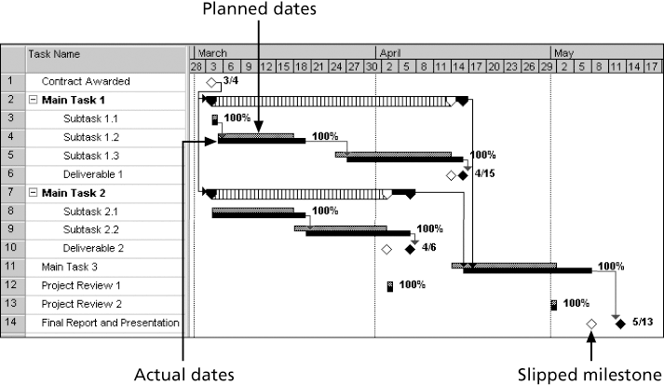
Figure 6-7. Sample Tracking Gantt Chart

Slide 41
Critical Path Method (CPM)
CPM is a network diagramming technique used to predict total project duration
A critical path for a project is the series of activities that determines the earliest time by which the project can be completed
The critical path is the longest path through the network diagram and has the least amount of slack or float
Slack or float is the amount of time an activity may be delayed without delaying a succeeding activity or the project finish date

Slide 42
Calculating the Critical Path
First develop a good network diagram
Add the duration estimates for all activities on each path through the network diagram
The longest path is the critical path
If one or more of the activities on the critical path takes longer than planned, the whole project schedule will slip unless the project manager takes corrective action

Slide 43
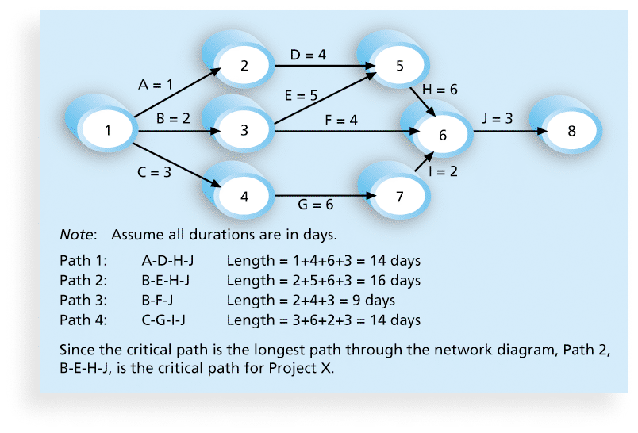
Figure 6-8. Determining the Critical Path for Project X

Slide 44
More on the Critical Path
A project team at Apple computer put a stuffed gorilla on the top of the cubicle of the person currently managing critical task
The critical path is not the one with all the critical activities; it only accounts for time
  Remember the example of growing grass being on the critical path for Disney’s Animal Kingdom
There can be more than one critical path if the lengths of two or more paths are the same
The critical path can change as the project progresses

Slide 45
Using Critical Path Analysis to Make Schedule Trade-offs
Free slack or free float is the amount of time an activity can be delayed without delaying the early start of any immediately following activities
Total slack or total float is the amount of time an activity may be delayed from its early start without delaying the planned project finish date
A forward pass through the network diagram determines the early start and finish dates
A backward pass determines the late start and finish dates

Slide 46
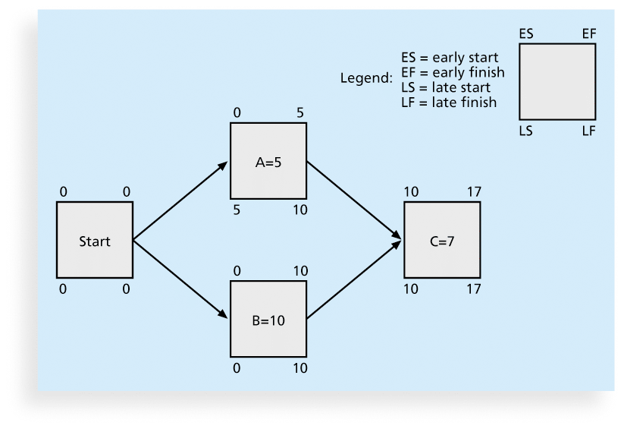
Figure 6-9. Calculating Early and Late Start and Finish Dates

Slide 47
总时差（总浮动时间）=LS-ES=LF-EF（指一项工作在不影响总工期的前提下所具有的动机时间）
自由浮动=min（随后活动的ES-当前活动的EF）（指一项工作在不影响后续工作的情况下所拥有的动机时间）
关键活动（关键路径上的活动）的总时差，自由时差都是0

Slide 48
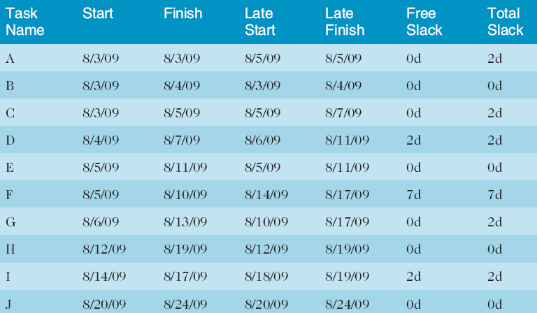
Table 6-1. Free and Total Float or Slack for Project X

Slide 49
Using the Critical Path to Shorten a Project Schedule
Three main techniques for shortening schedules
  Shortening durations of critical activities/tasks by adding more resources or changing their scope
  Crashing activities by obtaining the greatest amount of schedule compression for the least incremental cost
  Fast tracking activities by doing them in parallel or overlapping them

Slide 50
Importance of Updating Critical Path Data
It is important to update project schedule information to meet time goals for a project
The critical path may change as you enter actual start and finish dates
If you know the project completion date will slip, negotiate with the project sponsor

Slide 51
Critical Chain Scheduling
Critical chain scheduling
  a method of scheduling that considers limited resources when creating a project schedule and includes buffers to protect the project completion date
Uses the Theory of Constraints (TOC)
  a management philosophy developed by Eliyahu M. Goldratt and introduced in his book The Goal.
Attempts to minimize multitasking
  when a resource works on more than one task at a time

Slide 52
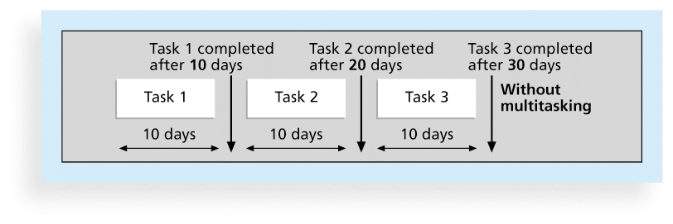
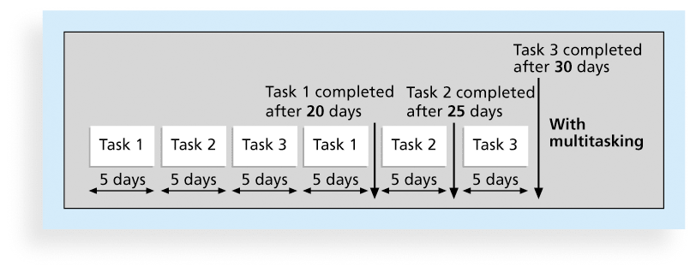
Figures 6-10.a and b. Multitasking Example

Slide 53
Buffers and Critical Chain
A buffer is additional time to complete a task
Murphy’s Law states that if something can go wrong, it will
Parkinson’s Law states that work expands to fill the time allowed
In traditional estimates, people often add a buffer to each task and use it if it’s needed or not
Critical chain scheduling removes buffers from individual tasks and instead creates
  a project buffer or additional time added before the project’s due date
  feeding buffers or additional time added before tasks on the critical path

Slide 54
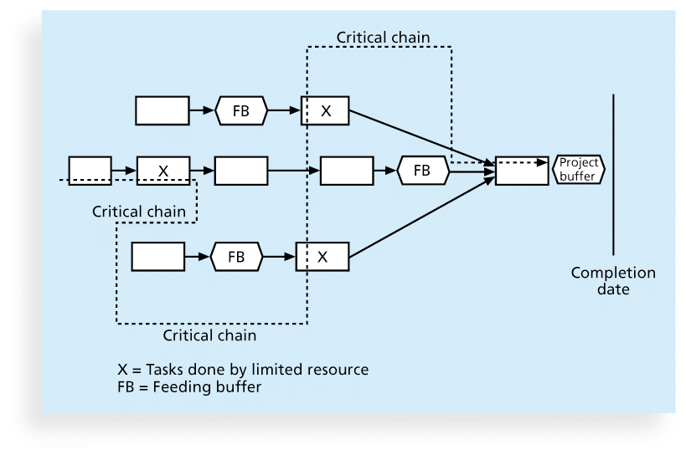
Figure 6-11. Example of Critical Chain Scheduling

Slide 55
Program Evaluation and Review Technique (PERT)
PERT is a network analysis technique used to estimate project duration when there is a high degree of uncertainty about the individual activity duration estimates
PERT uses probabilistic time estimates
  duration estimates based on using optimistic, most likely, and pessimistic estimates of activity durations, or a three-point estimate

Slide 56
PERT Formula and Example
PERT weighted average =
optimistic time + 4X most likely time + pessimistic time
6
Example:
PERT weighted average =
8 workdays + 4 X 10 workdays + 24 workdays = 12 days 6
where optimistic time= 8 days
most likely time = 10 days, and
pessimistic time = 24 days
Therefore, you’d use 12 days on the network diagram instead of 10 when using PERT for the above example

Slide 57
Controlling the Schedule
Goals are to know the status of the schedule, influence factors that cause schedule changes, determine that the schedule has changed, and manage changes when they occur
Tools and techniques include
  Progress reports
  A schedule change control system
  Project management software, including schedule comparison charts like the tracking Gantt chart
  Variance analysis, such as analyzing float or slack
  Performance management, such as earned value (chapter 7)

Slide 58
Reality Checks on Scheduling
First review the draft schedule or estimated completion date in the project charter
Prepare a more detailed schedule with the project team
Make sure the schedule is realistic and followed
Alert top management well in advance if there are schedule problems

Slide 59
Global Issues
Mittal Steel Poland earned Poland’s Project Excellence Award in 2007 for implementing a SAP system
Derek Prior, research director at AMR Research, identified three things the most successful SAP implementation projects do to deliver business benefits:
  Form a global competence centre
  Identify super-users for each location
  Provide ongoing involvement of managers in business processes so they feel they own these processes

Slide 60
Using Software to Assist in Time Management
Software for facilitating communications helps people exchange schedule-related information
Decision support models help analyze trade-offs that can be made
Project management software can help in various time management areas

Slide 61
What Went Right?
Microsoft lists dozens of examples of how customers benefit from using Project 2010. One such customer, Amdocs, a global provider of customer experience systems (CES) software, wanted to help its IT project teams work more efficiently
Employees now have Web-based access from any location, managers have better project visibility, and the company can extend the centralized solution to include more users and applications. Amdocs can now deploy Project Server 2010 in less than a day, or 50 percent faster. Only one person is needed to manage the shared infrastructure.

Slide 62
Words of Caution on Using Project Management Software
Many people misuse project management software because they don’t understand important concepts and have not had training
You must enter dependencies to have dates adjust automatically and to determine the critical path
You must enter actual schedule information to compare planned and actual progress

Slide 63
Chapter Summary
Project time management is often cited as the main source of conflict on projects, and most IT projects exceed time estimates
Main processes include
  Plan schedule management
  Define activities
  Sequence activities
  Estimate activity resources
  Estimate activity durations
  Develop schedule
  Control schedule

Slide 64
练习
1、下列哪个过程包括将用于计划、执行和控制项目进度的确定的政策、程序和文档？
A.进度管理计划
B.活动定义
C.活动资源估算
D.活动排序
‎2、前导活动、后继活动、逻辑关系、提前和滞后、资源需求、约束、强制日期，以及假设都是___的例子。
A.活动列表项
B.项目甘特图项
C.里程碑属性
D.活动属性

Slide 65
练习
1、下列哪个过程包括将用于计划、执行和控制项目进度的确定的政策、程序和文档？A
A.进度管理计划
B.活动定义
C.活动资源估算
D.活动排序
‎2、前导活动、后继活动、逻辑关系、提前和滞后、资源需求、约束、强制日期，以及假设都是_D__的例子。
A.活动列表项
B.项目甘特图项
C.里程碑属性
D.活动属性

Slide 66
练习
3、作为一个软件开发项目的项目经理，你正在帮助开发项目进度。你认为在用户签署同意所有分析工作之前项目团队不应该开始为系统编写代码。这是什么样的依赖关系？
A.技术 B.强制
C.自由 D.外部
‎4、你不能开始编辑一份技术报告，直到有人完成初稿。这代表什么类型的依赖？
A.完成-开始
B.开始-开始
C.完成-完成
D.开始-完成

Slide 67
练习
3、作为一个软件开发项目的项目经理，你正在帮助开发项目进度。你认为在用户签署同意所有分析工作之前项目团队不应该开始为系统编写代码。这是什么样的依赖关系？
A.技术 B.强制 C
C.自由 D.外部
‎4、你不能开始编辑一份技术报告，直到有人完成初稿。这代表什么类型的依赖？ A
A.完成-开始
B.开始-开始
C.完成-完成
D.开始-完成

Slide 68
练习
5、下列哪种说法是错误的？
A.资源分解结构是一种层次结构，可以按照种类和类型确定项目资源
B.工期和人工量是同义词
C.三点估算包括乐观、最可能和悲观的估算
D.甘特图是显示项目进度信息的常用工具
6、在甘特图上什么符号表示一个偏移的里程碑？
A.黑色箭头
B.白色箭头
C.黑色菱形
D.白色菱形

Slide 69
练习
5、下列哪种说法是错误的？ B
A.资源分解结构是一种层次结构，可以按照种类和类型确定项目资源
B.工期和人工量是同义词
C.三点估算包括乐观、最可能和悲观的估算
D.甘特图是显示项目进度信息的常用工具
6、在甘特图上什么符号表示一个偏移的里程碑？ D
A.黑色箭头
B.白色箭头
C.黑色菱形
D.白色菱形

Slide 70
练习
7、什么类型的图显示计划和实际项目进度的信息？
A.网络图
B.甘特图
C.跟踪甘特图
D.里程碑图
8、___是用来预测总的项目工期的网络图技术。
A.PERT
B.甘特图
C.关键路径法
D.赶工

Slide 71
练习
7、什么类型的图显示计划和实际项目进度的信息？ C
A.网络图
B.甘特图
C.跟踪甘特图
D.里程碑图
8、_C__是用来预测总的项目工期的网络图技术。
A.PERT
B.甘特图
C.关键路径法
D.赶工

Slide 72
练习
9、下面哪种说法是错误的？
A.在一个大型主题公园的关键路径上种草
B.关键路径是确定活动最早完成时间的活动序列
C.通过网络图确定每个活动的最早开始时间和最早完成时间
D.快速跟进是一种权衡成本和进度以最小的成本获取最大的进度的技术
10、___是一种进度计划方法，在创建项目进度时考虑有限的资源，并且将缓冲包括进来以保护项目完成期限。
A.帕金森定律
B.墨菲定律
C.关键路径分析
D.关键链调度

Slide 73
练习
9、下面哪种说法是错误的？ D
A.在一个大型主题公园的关键路径上种草
B.关键路径是确定活动最早完成时间的活动序列
C.通过网络图确定每个活动的最早开始时间和最早完成时间
D.快速跟进是一种权衡成本和进度以最小的成本获取最大的进度的技术
10、_D__是一种进度计划方法，在创建项目进度时考虑有限的资源，并且将缓冲包括进来以保护项目完成期限。
A.帕金森定律
B.墨菲定律
C.关键路径分析
D.关键链调度

Slide 74
讨论问题
1、项目时间管理中的7个主要过程
2、一个进度管理计划应该包括哪些信息？
3、依赖的三种类型
4、辅助进度制订过程的工具和技术有哪些？
5、SMART准则是怎样定义里程碑的？
6、使用关键路径来缩短项目进度有哪三个主要技术？

Slide 75
讨论问题
1、项目时间管理中的7个主要过程
计划进度管理
定义活动
排序活动
估算活动资源
估算活动工期
制订进度计划
控制进度

Slide 76
讨论问题
2、一个进度管理计划应该包括哪些信息？
项目进度模型的开发
在开发项目进度模型中使用的方法和工具
精度水平和计量单位
控制阈值
性能测量的规则
报告格式
过程描述

Slide 77
讨论问题
3、依赖的三种类型
强制依赖
自由依赖
外部依赖

Slide 78
讨论问题
4、辅助进度制订过程的工具和技术有哪些？
甘特图
关键路径分析
关键链进度法
PERT分析

Slide 79
讨论问题
5、SMART准则是怎样定义里程碑的？
Specific 明确的
Measurable 可度量的
Assignable 可分配的
Realistic 现实的
Time-framed 有时间限制的

Slide 80
讨论问题
6、使用关键路径来缩短项目进度有哪三个主要技术？
为活动分配更多的资源或者改变它们的范围
赶工
快速跟进

Slide 81
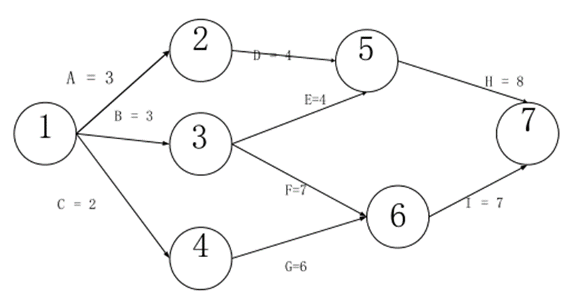
计算题
Consider the following project network diagram. Assume all times are in days
1. How many paths are on this network diagram?
2. How long is each path?
3. Which is the critical path?
4. What is the shortest amount of time needed to complete this project?

